Slide 1


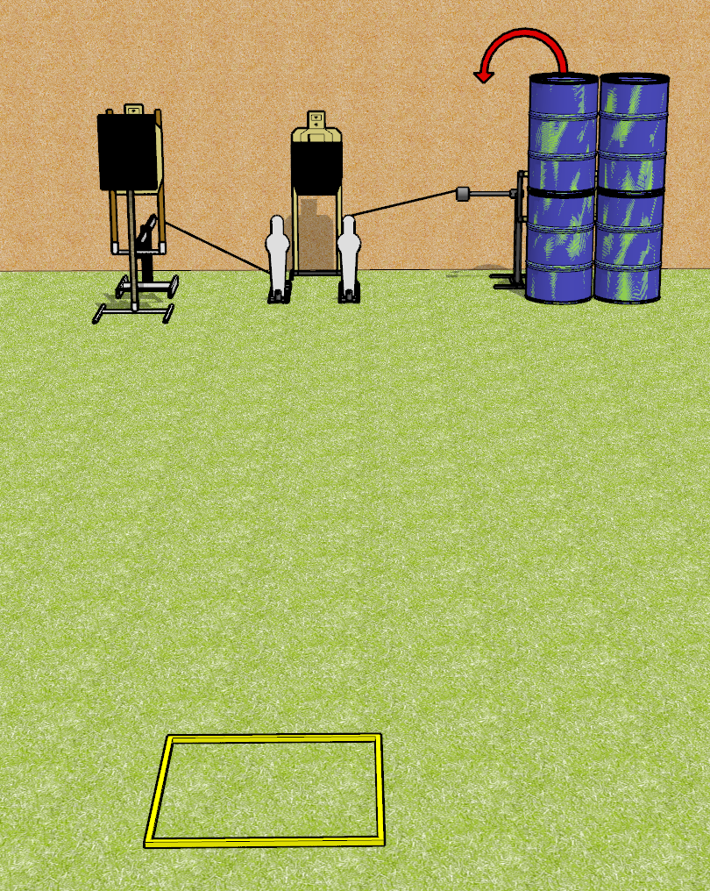
 | Dothan Gun Club – USPSA Match Bob It Course Designer : Drew Coleman
Round Count 8 Rounds 3 USPSA 2 Mini poppers
Equipment List 1 bobber + steel challenge plate and stand + activator 1 swinger + activator Shooting box

Slide 2
Bob It
Written Stage Briefing
Bob It is an 8 round, 40 point, Comstock speed shoot. There are 3 USPSA targets and 2 mini poppers. The best 2 hits on paper will score, and steel must fall to score. The start signal is audible.
The left popper activates the bobber which is a disappearing target. The right popper activates the swinger which remains visible at rest.
Handgun start position is in shooting box, wrists below belt. Handgun is loaded and holstered.
PCC start position is in shooting box, stock on belt. Carbine is loaded, safety on.
On start signal, engage targets as they become available from within the shooting area.

Slide 3
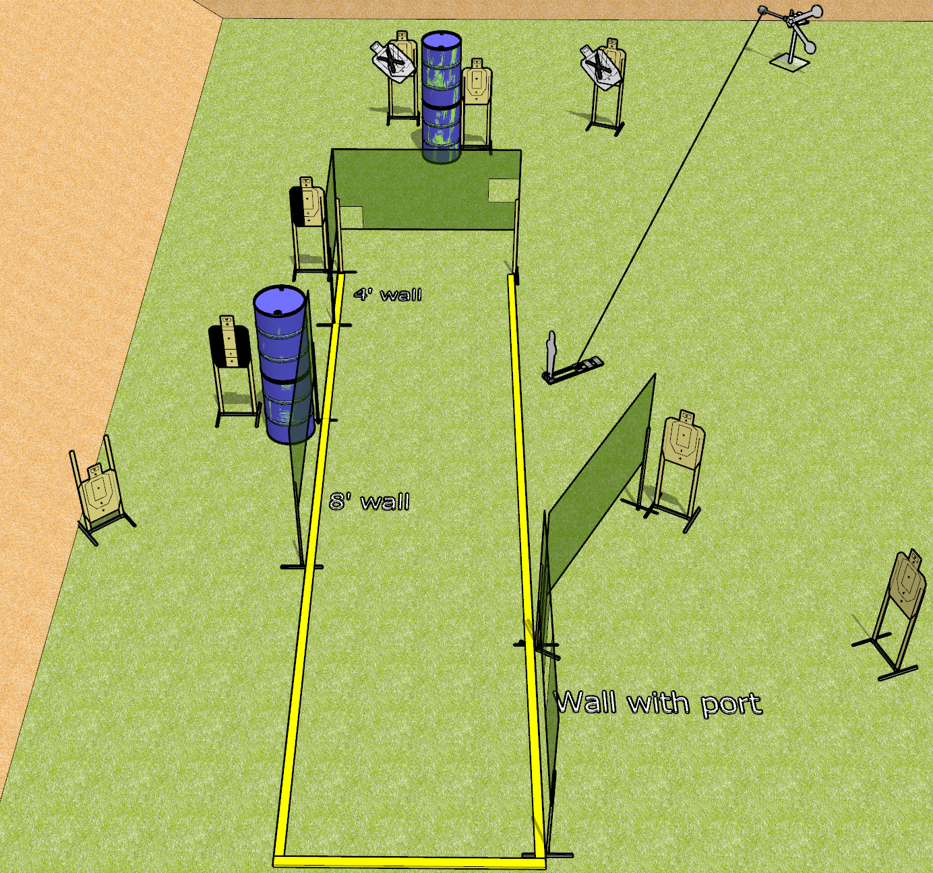
 | Dothan Gun Club – USPSA Match Sidekick Course Designer : Drew Coleman
Round Count 18 rounds 8 USPSA 2 steel
Equipment List Red Stich target + activator + mini popper OR stomp box

Slide 4
Sidekick
Written Stage Briefing
Sidekick is an 18 round, 90 point, Comstock course of fire. There are 8 USPSA targets, and 2 falling plates. The best 2 hits on paper will score, and steel must fall to score. The start signal is audible.
The swinging plates must be activated before being engaged. They are activated by the knock down popper/stomp box.
Handgun start position is anywhere outside the shooting area, wrists below belt. Handgun is loaded and holstered.
PCC start position is anywhere outside the shooting area, stock on belt. Carbine is loaded, safety on.
On start signal, engage targets as they become available from within the shooting area.

Slide 5
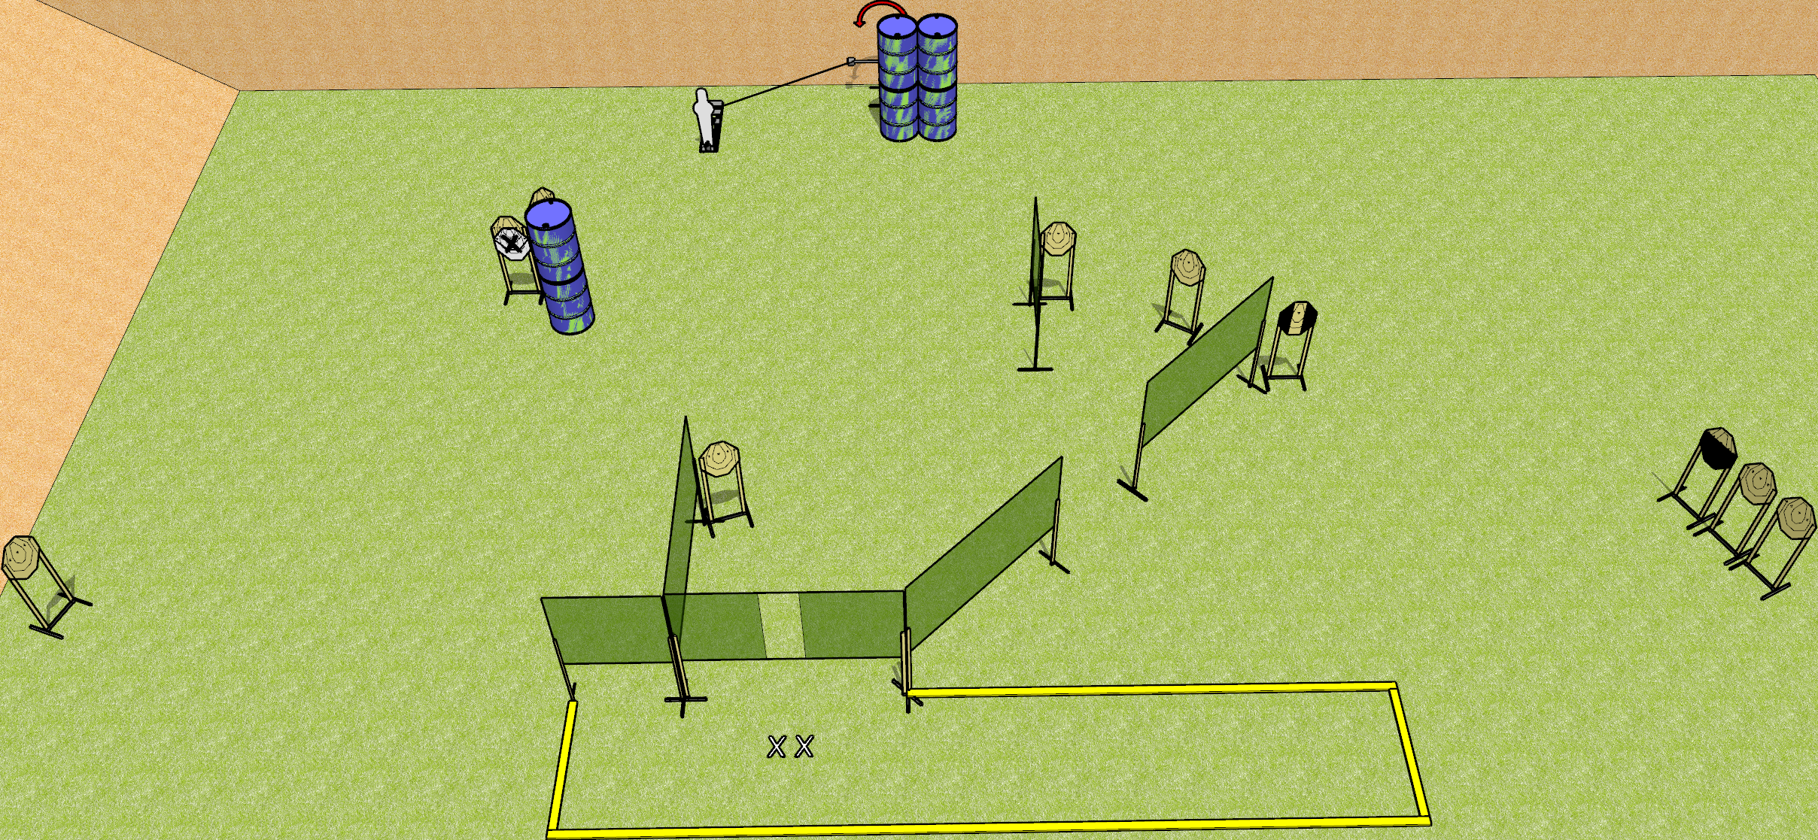
 | Dothan Gun Club – USPSA Match Something Course Designer : Drew Coleman
Round Count 23 rounds 11 IPSC 1 popper
Equipment List 1 swinger + activator 9 wall feet 2 medium fault lines 1 tux, 1 25%

Slide 6
Something
Written Stage Briefing
Something is a 23 round, 115 point, Comstock course of fire. There are 11 IPSC targets and 1 popper. The best 2 hits on paper will score, and steel must fall to score. The start signal is audible.
The swinger is activated by the popper, and remains visible at rest.
Handgun start position is both feet on X’s, wrists below belt. Handgun is loaded and holstered.
PCC start position is both feet on X’s, stock on belt. Carbine is loaded
On start signal, engage targets as they become available from within the shooting area.

Slide 7
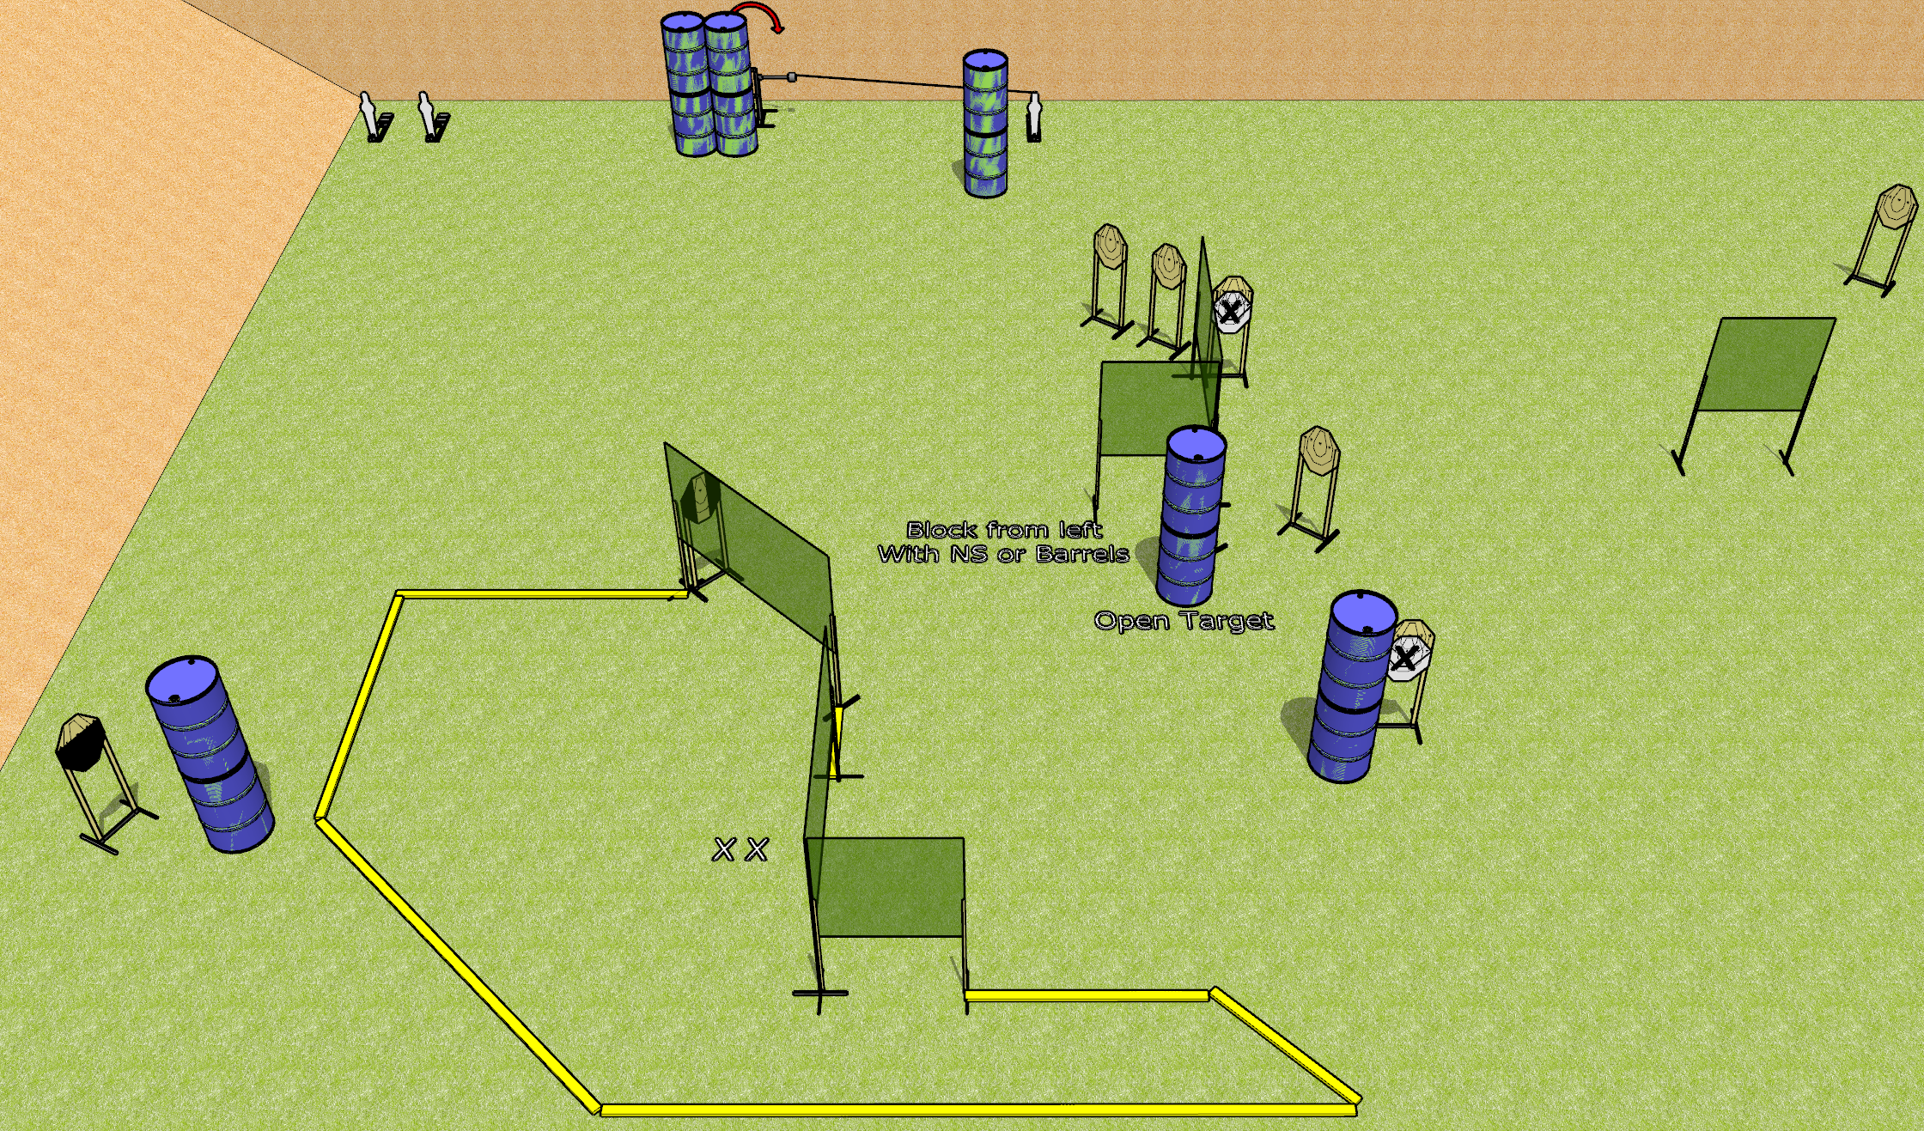
 | Dothan Gun Club – USPSA Match To the Extreme Course Designer : Drew Coleman
Round Count 23 rounds 10 IPSC 3 mini poppers
Equipment List 12 wall feet 1 medium fault line, 2 3’ fault lines 1 swinger + activator 1 tuxedo, 1 50% Aligning the activator steel: line it up with the middle of the fault line to the right of the narrow wall at the bottom of the shooting area, at 50 feet

Slide 8
To the Extreme
Written Stage Briefing
To the Extreme is a 23 round, 115 point, Comstock course of fire. There are 10 IPSC targets and 3 mini poppers. The best 2 hits on paper will score, and steel must fall to score. The start signal is audible.
The swinger is activated by the rightmost mini popper and remains visible at rest.
Handgun start position is both feet on X’s, wrists below belt. Handgun is loaded and holstered.
PCC start position is both feet on X’s, stock on belt. Loaded carbine is loaded with safety on.
On start signal, engage targets as they become available from within the shooting area.

Slide 9
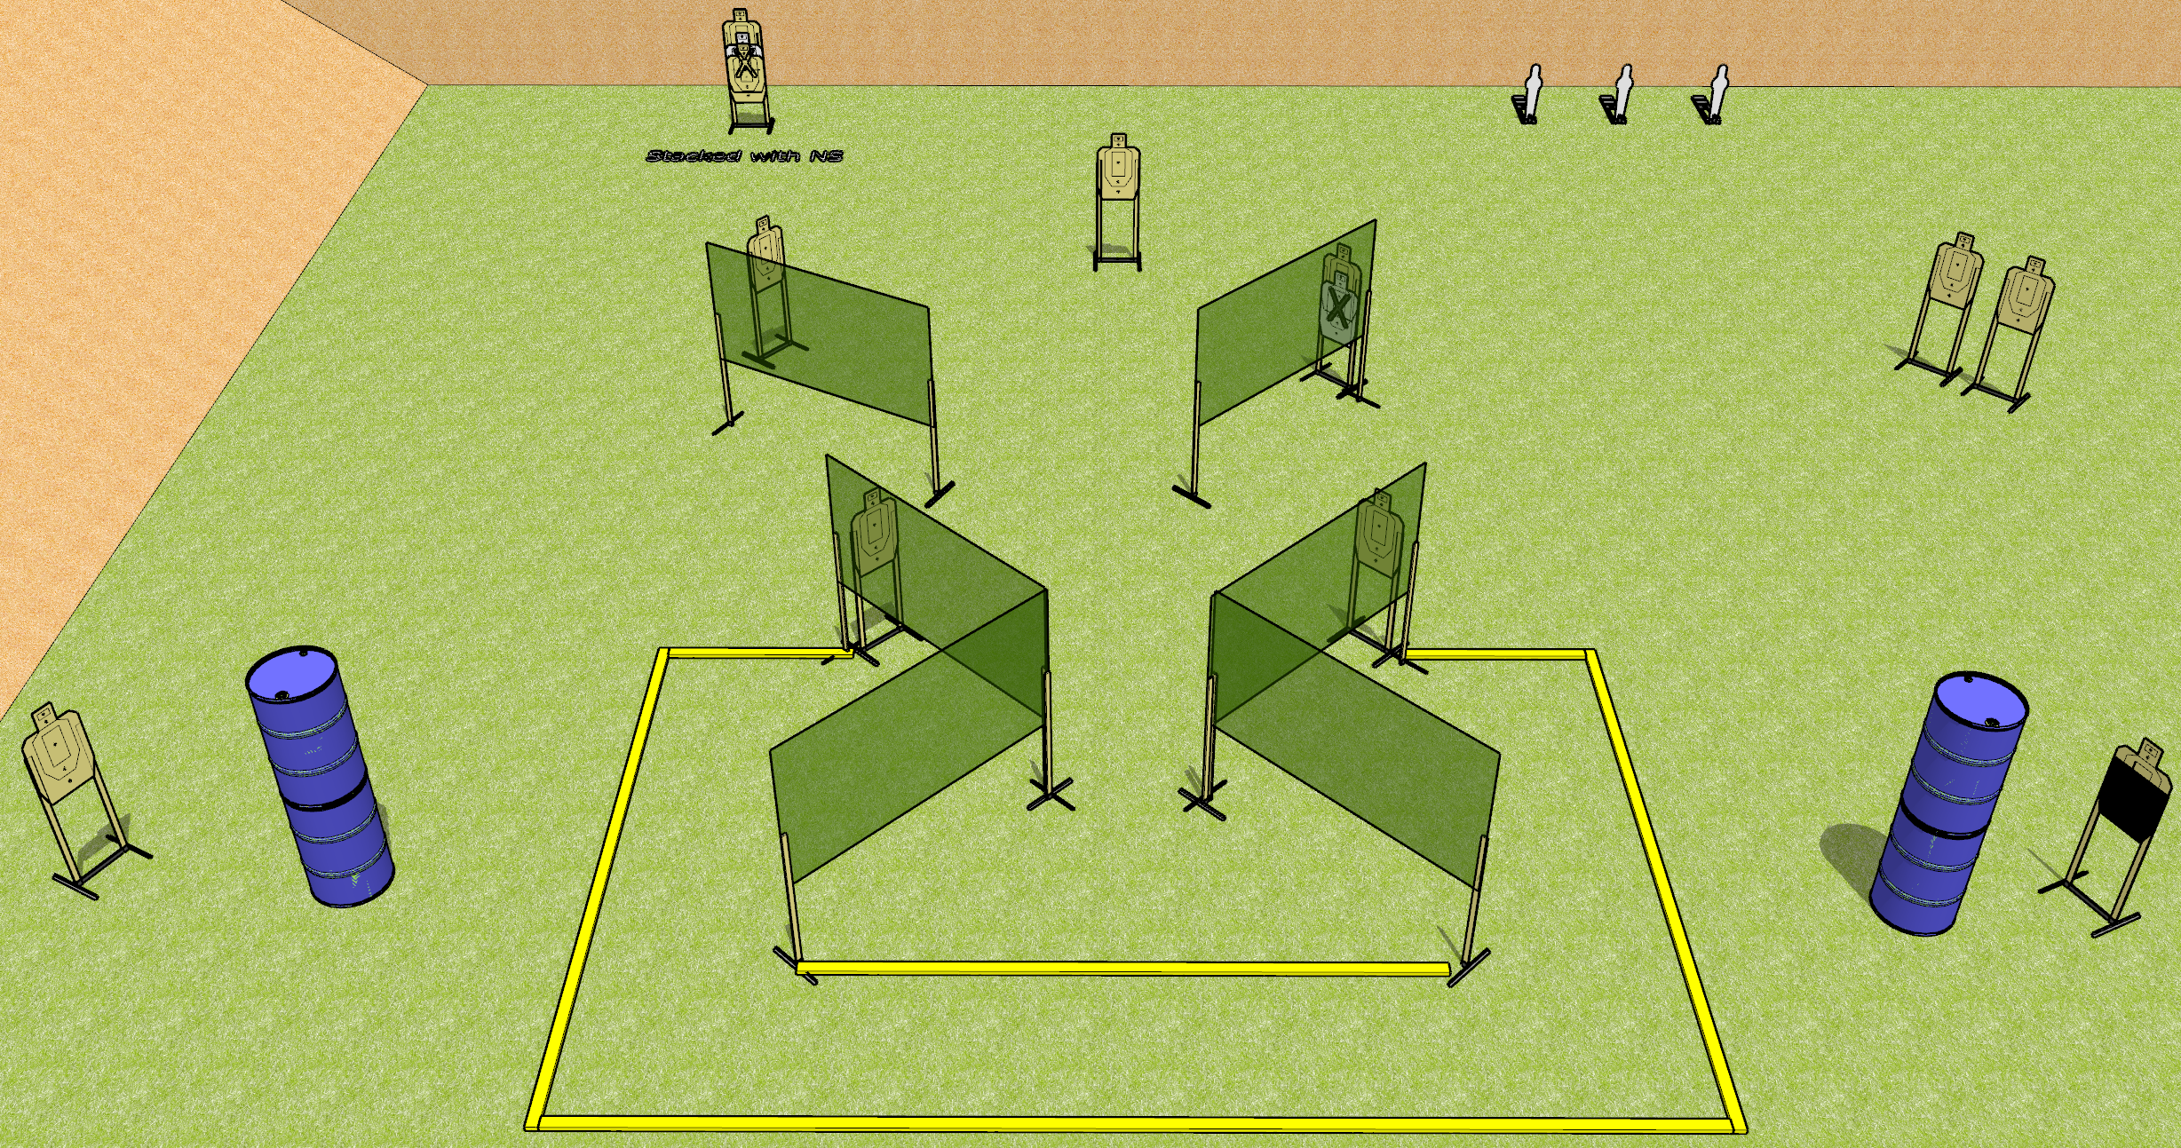
 | Dothan Gun Club – USPSA Match Bringing Pain Again Course Designer : Drew Coleman
Round Count 25 rounds 12 USPSA 3 mini poppers
Equipment List 2 medium fault lines 10 wall feet 1 action target

Slide 10
Bringing Pain Again
Written Stage Briefing
Bringing Pain Again is a 25 round, 125 point, Comstock course of fire. There are 12 USPSA targets and 3 mini poppers. The best 2 hits on paper will score, and steel must fall to score. The start signal is audible.
Handgun start position is in the shooting area, wrists below belt. Handgun is loaded and holstered.
PCC start position is in the shooting area, stock on belt. Carbine is loaded with safety on.
On start signal, engage targets as they become available from within the shooting area.

Slide 11
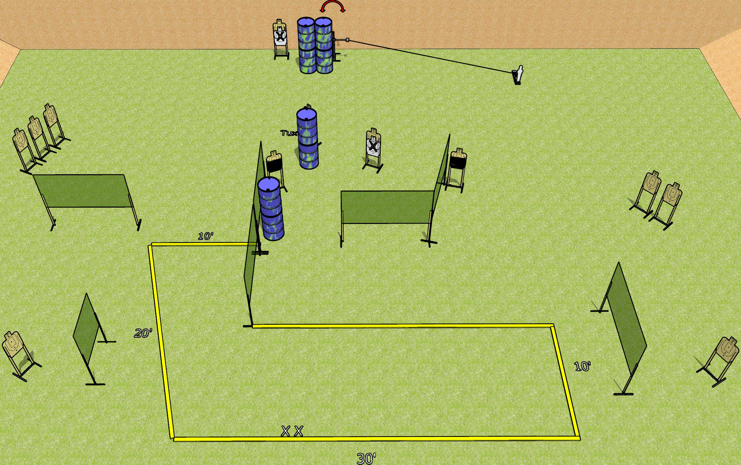
 | Dothan Gun Club – USPSA Match Strong Shift Course Designer : Drew Coleman
Round Count 27 rounds 13 USPSA 1 mini popper
Equipment List 1 swinger + activator 13 wall feet 2 50%, 1 Tuxedo

Slide 12
Strong Shift
Written Stage Briefing
Strong shift is a 27 round, 135 point, Comstock course of fire. There are 13 USPSA targets and 1 mini popper. The best 2 hits on paper will score, and steel must fall to score. The start signal is audible.
The swinger is activated by the mini popper and remains visible at rest.
Handgun start position is both feet on X’s, wrists below belt. Handgun is loaded and holstered.
PCC start position is both feet on X’s, stock on belt. Loaded carbine is held with both hands, safety on.
On start signal engage targets as they become available from within the shooting area.

Slide 13
 | Dothan Gun Club – USPSA Match Shoot House Course Designer : Does anyone read these things?
Round Count
Equipment List

Slide 14
Shoot House
Written Stage Briefing

